Slide 1
BA TECHNOLOGY, DATA, & INSIGHT
WEB SCRAPPING

Slide 2
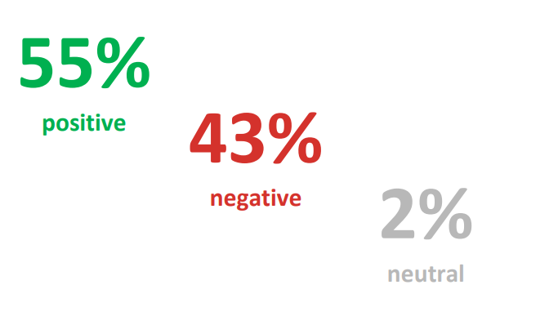
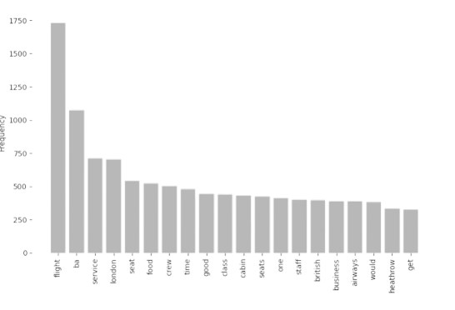
RESULTS
Key topics
The frequency chart below shows that the key topics within the reviews include “service”, “seat”, “crew” and “staff”, showing that people are actively talking about their experience and staff.
Sentiment Out of 1000 reviews, 546 were positive, 437 were negative and 17 were neutral. This means the majority of reviews were polarised as either positive or negative.

